Slide 1
Lecture 30: Generative Adversarial Networks (GANS) – part 2

Slide 3
Lecture outline
Review
Generative Models
Mode collapse
Evaluate GANs
Inception score
Train Synthetic Test Real
Fréchet Distance
State of the Art GANs
Deep Convolutional GAN: DCGAN
Auxiliary Classifier GANs
Recent updates
Concluding remarks

Slide 4
Lecture outline
Review
Generative Models
Mode collapse
Evaluate GANs
Inception score
Train Synthetic Test Real
Fréchet Distance
State of the Art GANs
Deep Convolutional GAN: DCGAN
Auxiliary Classifier GANs
Recent updates
Concluding remarks

Slide 5
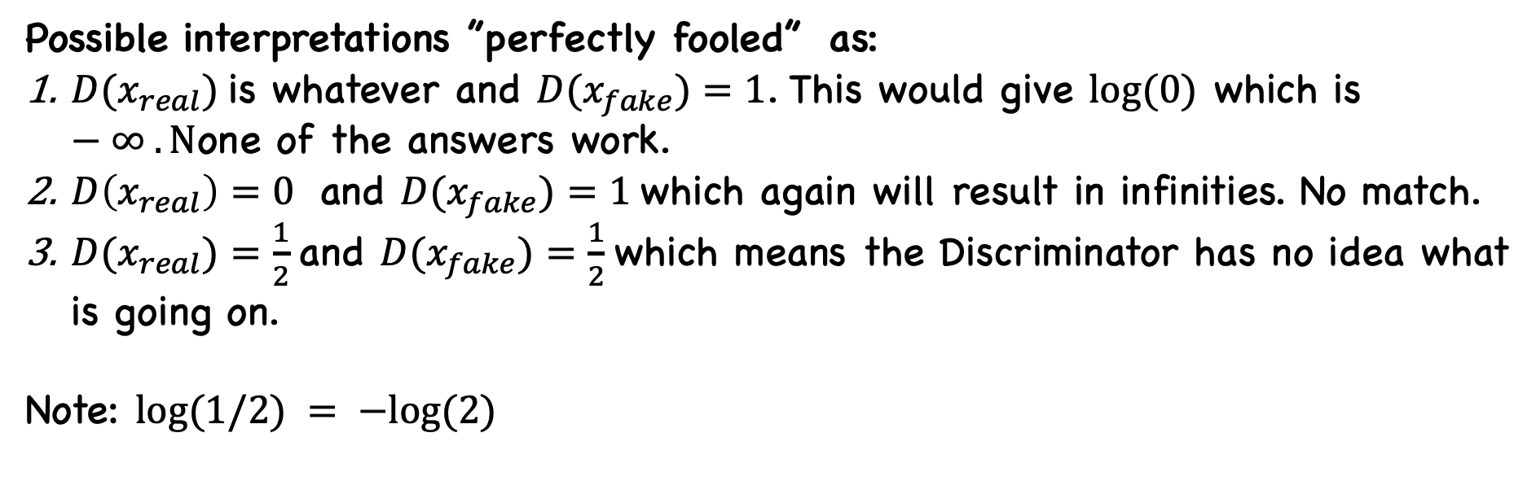
Quiz Q1
Fooled means D can not tell real from fake
Possible interpretations ”perfectly fooled” as:
$D(x_{real})$is whatever and $D(x_{fake})=1$. This would give $log⁡(0)$ which is $−∞ . N$one of the answers work.
$D\left(x_{real}\right)=0$ and $D(x_{fake})=1$which again will result in infinities. No match.
$D(x_{real})=\frac{1}{2}$and $D(x_{fake})=\frac{1}{2}$which means the Discriminator has no idea what is going on.
Note: $log⁡(1/2) = −log⁡(2)$

Slide 6
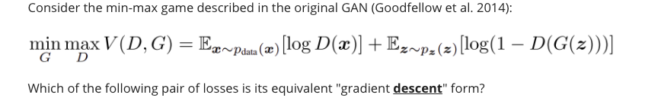
Quiz Q2
Descent means minimize
D maximizes this:
D minimizes this:
G minimizes this:

Slide 7

Image-to-Image Translation using Cycle-GANs
[Zhu et al. 2017]

Slide 8
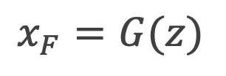
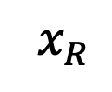
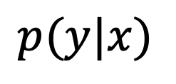
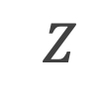
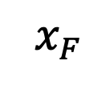
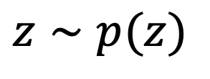
How we build a generator from GANS
Real data
$$x_{R}$$
Discriminator
Generator
$$p(y|x)$$
Classification
$$Z$$
$$x_{F}$$
$$z∼p(z)$$
Fake data
$$x_{F}=G(z)$$

Slide 9

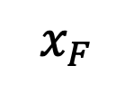
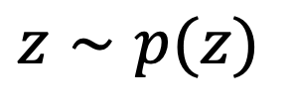

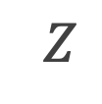
Generative Model
Generator
$$Z$$
$$x_{F}$$
$$z∼p(z)$$
$$x_{F}=G(z)$$
9

Slide 10
Game Theory
In some games there are unbounded resources. For example, in a game of poker, the pot can theoretically get larger and larger without limit.
Zero-sum game: Players compete for a fixed and limited pool of resources. Players compete for resources, claiming them and each player’s total number of resources can change, but the total number of resources remain constant.
In zero-sum games each player can try to set things up so that the other player’s best move is of as little advantage as possible. This is called a minimax, or minmax, technique.

Slide 11
Game Theory (cont)
Our goal in training the GAN is to produce two networks that are each as good as they can be. In other words, we don’t end up with a “winner.”
Instead, both networks have reached their peak ability given the other network’s abilities to prevent it. Game theorists call this state a Nash equilibrium, where each network is at its best configuration with respect to the other.

Slide 12
Challenges
Biggest challenge to using GANs in practice is their sensitivity to both structure and parameters.
If either the discriminator or generator gets better than the other too quickly, the other will never be able to catch up.
Also, there is no proof that they will converge.
GANs do seem to perform very well most of the time when we find the right parameters, but there’s no guarantee beyond that.

Slide 13
Challenges: Using Big Samples
Trying to train a GAN generator to produce large images, such as 1000 by 1000 pixels can be problematic.
The problem is that with large images, it’s easy for the discriminator to tell the generated fakes from the real images.
Many pixels can lead to error gradients that cause the generator’s output to move in almost random directions, rather than getting closer to matching the inputs.
Compute power, memory, and time to process large numbers of these big samples.

Slide 14
Challenges: Using Big Samples (cont)
Start by resizing the images: 512x512, 128x128, 64x64, … ,4x4.
Then build a small generator and discriminator, each with just a few layers of convolution.
Train with the 4 by 4 images until it does well.
Add a few more convolution layers to the end network, and now train them with 8 by 8 images. Again, when the results are good, add some more convolution layers to the end of each network and train them on 16 by 16 images.
This process takes much less time to complete than if we’d trained with only the full-sized images from the start.

Slide 15
Challenges: Mode collapse
I would like to use GAN to produce faces like the ones below from NVIDIA [Karras, Laine, Aila / Nvidia].

Slide 16
Challenges: Mode collapse (cont)
The generator somehow finds one image that fools the discriminator.
[Karras, Laine, Aila / Nvidia].

Slide 17
Challenges: Mode collapse (cont)
A generator could then just produce that image every time independently of the input noise.
The discriminator will always say it is real, so the generator has accomplished its goal and stops learning.
However: The problem is that every sample made by the generator is identical.
This problem of producing just one successful output over and over is called mode collapse.
[Karras, Laine, Aila / Nvidia].

Slide 18
Challenges: Modal collapse (cont)
Much more common is when the system produces the same few outputs, or minor variations of them.
This is called partial mode collapse
Solution:
Extend the loss function with an additional terms to measure the diversity of the outputs produced.
If the outputs are all the same, or nearly the same, the discriminator can assign a larger error to the result.
The generator will diversify because that action will reduce the error.
Use WGAN (see below)

Slide 19
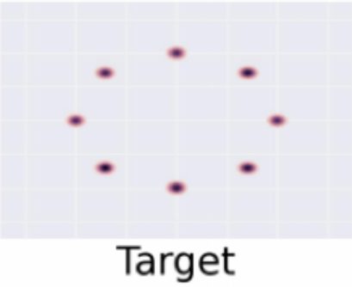
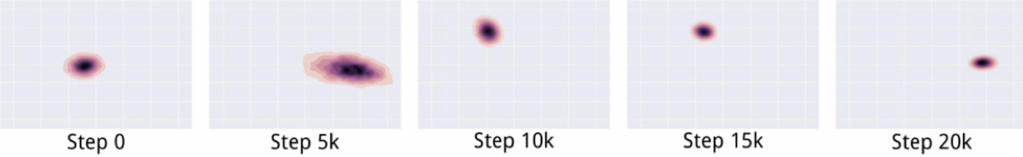
Challenges: Modal collapse (cont)

Slide 20
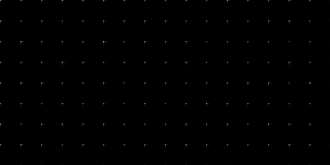
Challenges: Modal collapse (cont)
Credit: G. Garcia et al. 2018

Slide 21
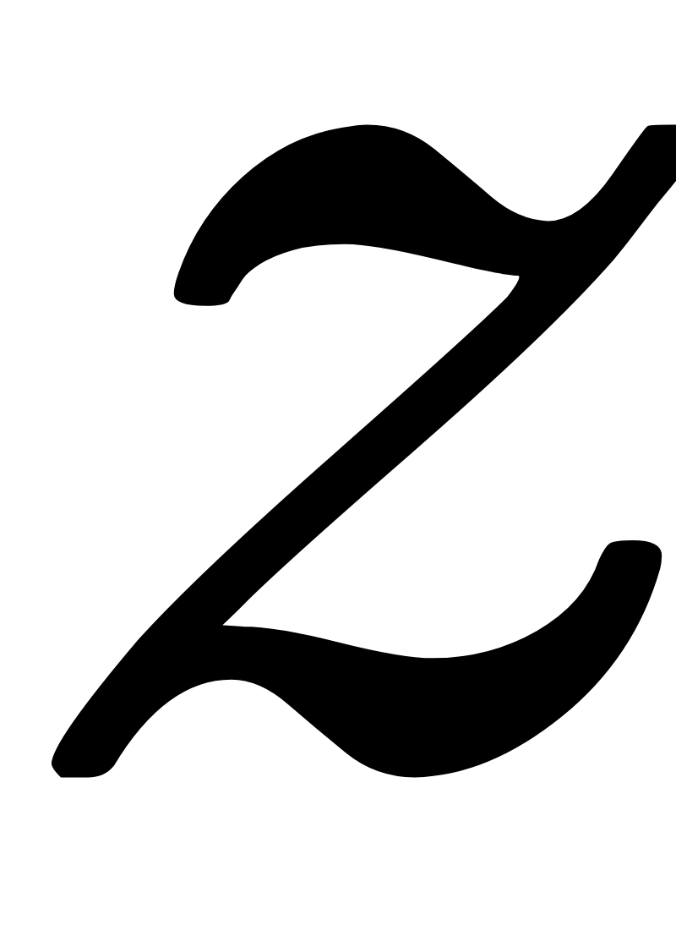
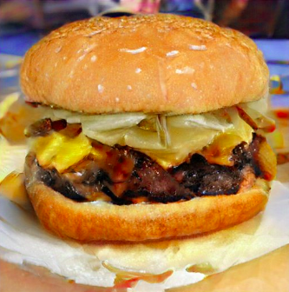
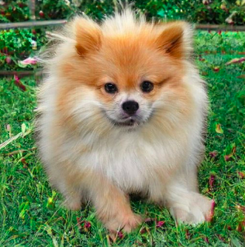

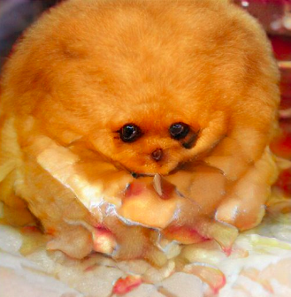
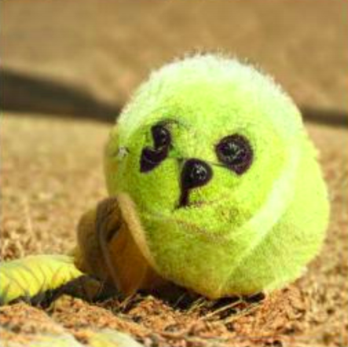
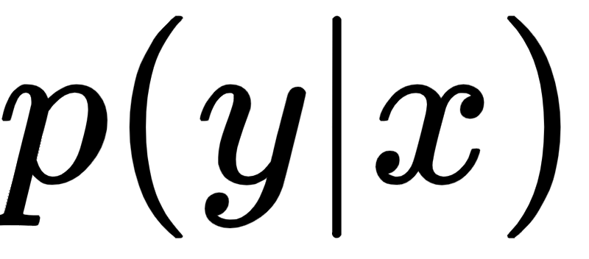
Evaluating GANs: Why is it challenging
Supervised Learning
GANs
??
Cheeseburger
Pomeranian
Could we use D?

Slide 22
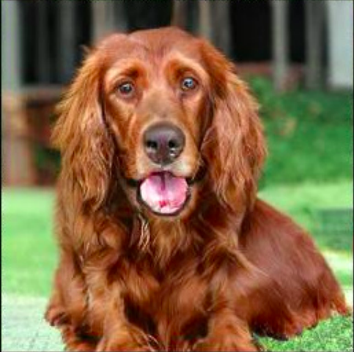
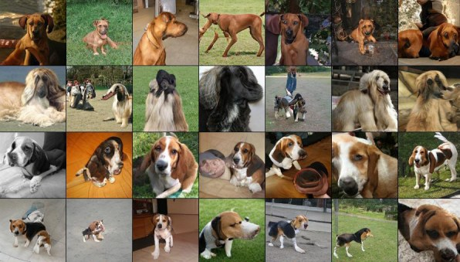
Evaluating GANs: What do we want from a Generator?
Fidelity: quality of images
Diversity: variety of images
[A Google intern built the AI behind these shockingly good fake images]

Slide 23
Evaluating GANs
How to evaluate the models ?
Human annotators
inception Score (IS)
Fréchet Inception Distance (FID)
Others… (IS*, SWD)
[Barrat et al., 2018]

Slide 24
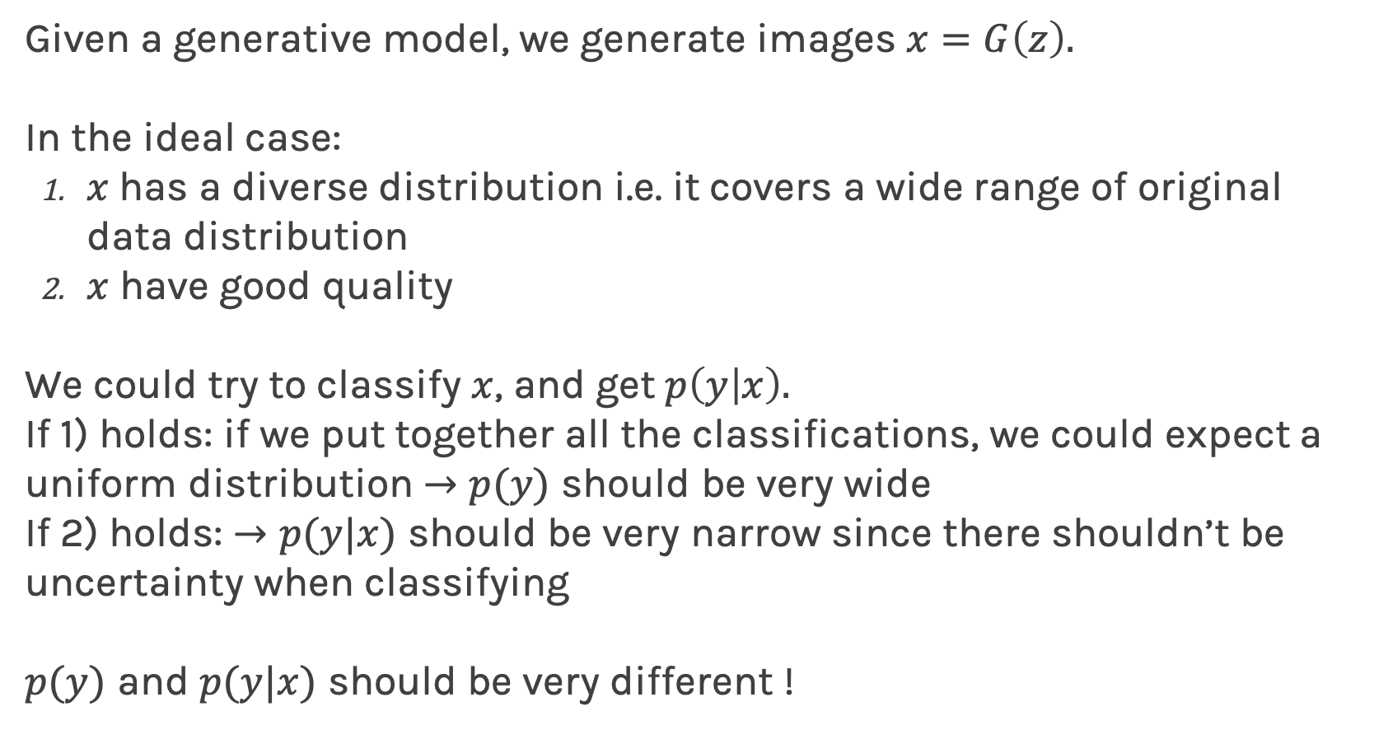
Evaluation
Given a generative model, we generate images $x=G\left(z\right).$
In the ideal case:
$x$has a diverse distribution i.e. it covers a wide range of original data distribution
$x$ have good quality
We could try to classify $x$, and get $p\left(y | x\right).$
If 1) holds: if we put together all the classifications, we could expect a uniform distribution $→p(y)$ should be very wide
If 2) holds: $→p(y|x)$ should be very narrow since there shouldn’t be uncertainty when classifying
$p(y)$ and $p(y|x)$ should be very different !

Slide 25
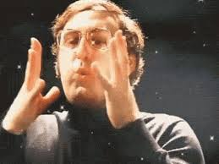
Evaluation (cont)
In order to do this, we need a good classifier.
In the context of images, why don’t we use the inception network,
and then call it inception score.

Slide 26
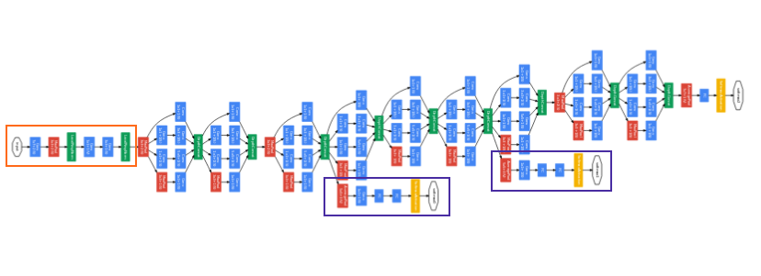
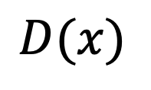
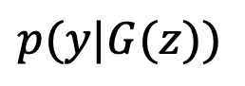
How we build a generator from GANS
Real data
Binary Classification
$$x_{R}$$
Discriminator
Generator
$$D(x)$$
Multi-Class Classification
Classification
$$Z$$
$$x_{F}$$
Inception network trained on real data
$$z∼p(z)$$
Fake data
$$x_{F}=G(z)$$
$$p(y|G(z))$$

Slide 27
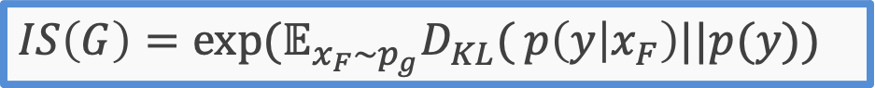
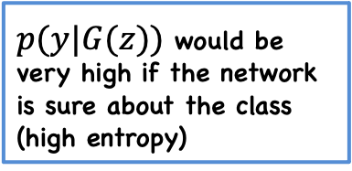
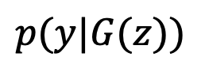
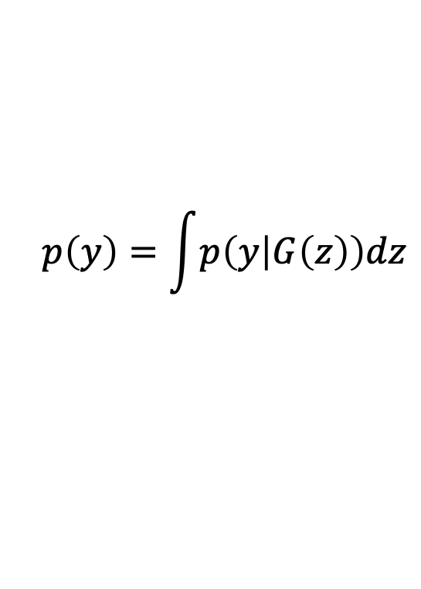
Evaluation: Inception Score
High quality means peaky distribution
Inception network trained on real data
$p(y|G(z))$ would be very high if the network is sure about the class (high entropy)
probability
$$p(y|G(z))$$
$$p\left(y\right)=\int{p\left(y | G\left(z\right)\right)dz}$$
High Inception Score means high quality and diverse generated data.
class
Distribution of labels which should be uniform (low entropy)
KL measures the difference of the two distributions. If we want high quality and diverse, KL has to be high.
Diversity means flat distribution
Inception Score:
$IS\left(G\right)=\exp{(𝔼_{x_{F}\sim p_{g}}D_{KL}(}p\left(y | x_{F}\right)||p(y))$

Slide 28
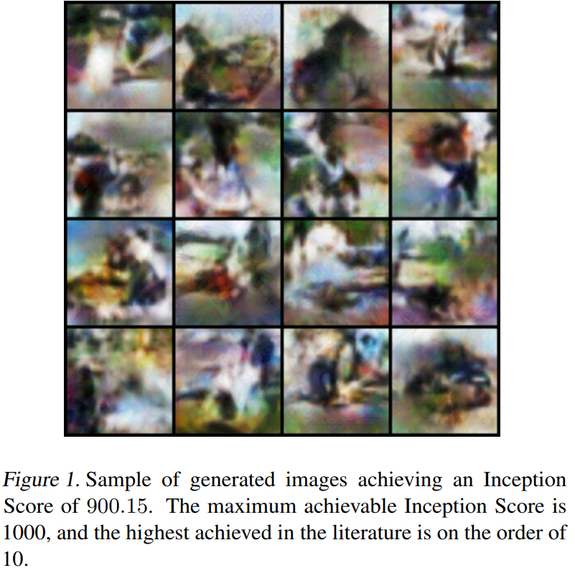
Evaluation: Inception Score
Inception Score is used for evaluation not for training.
Using IS for training, yields to weird results; see figure to the right.

Slide 29
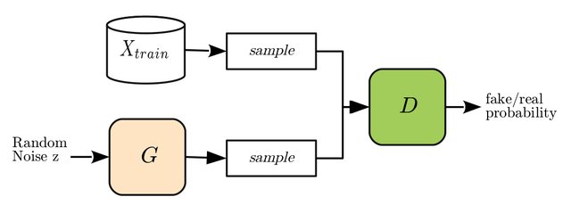
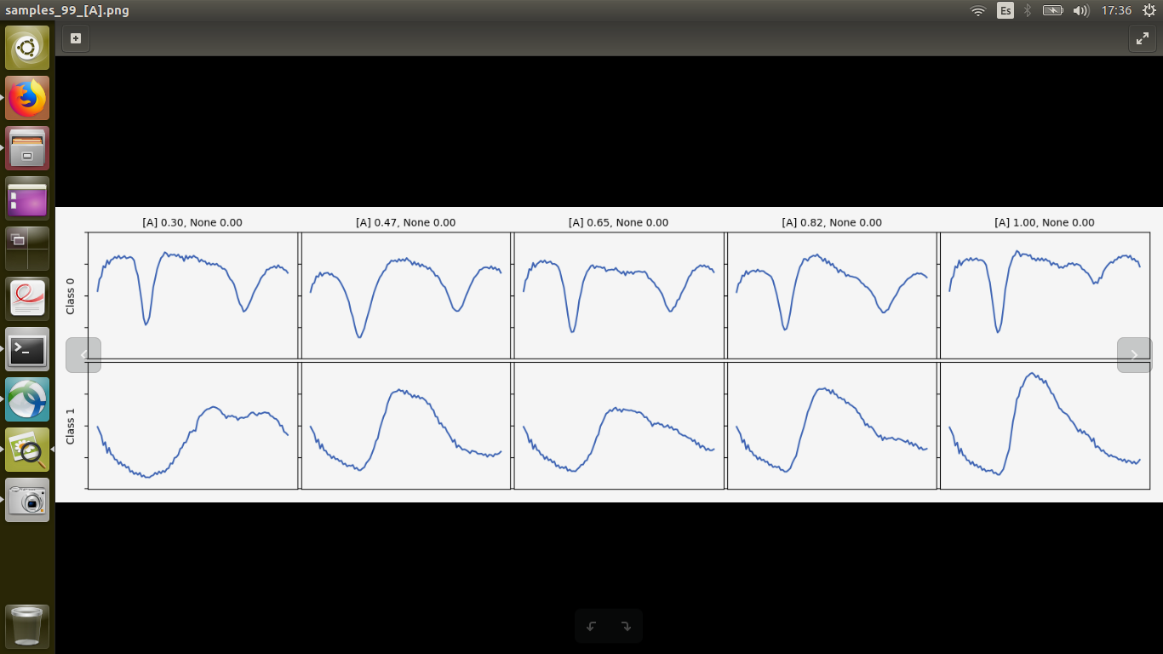
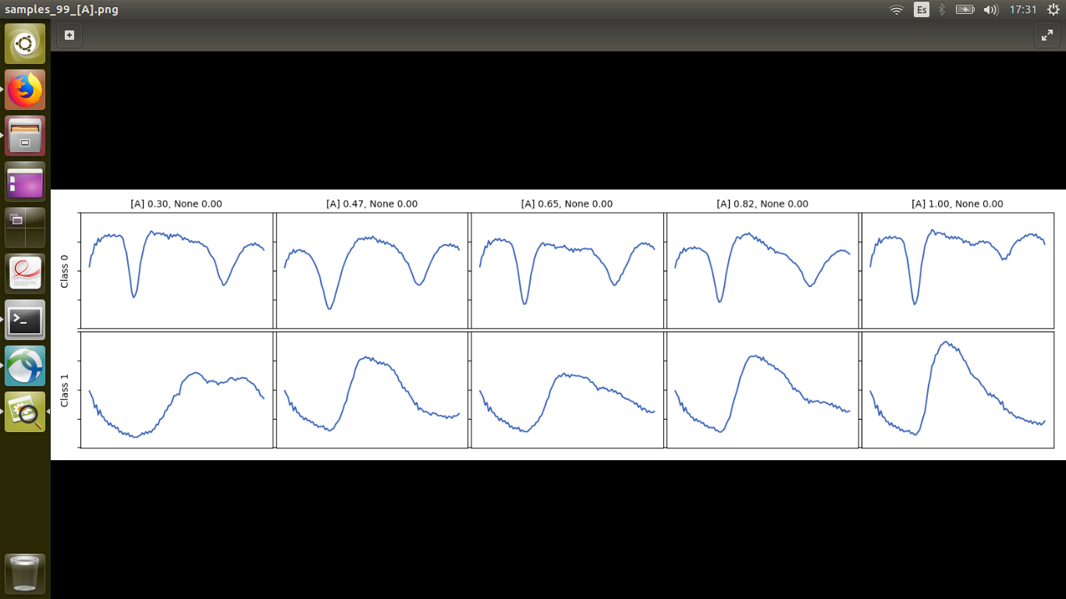
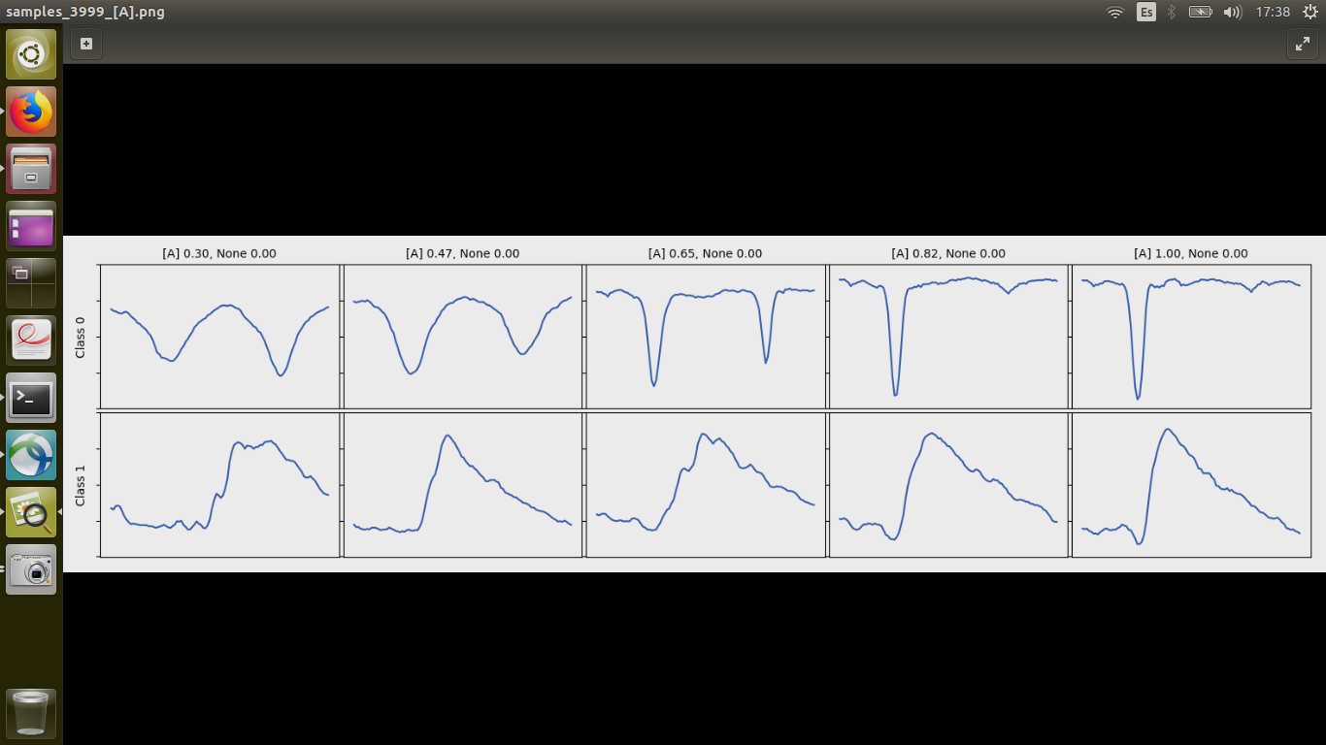
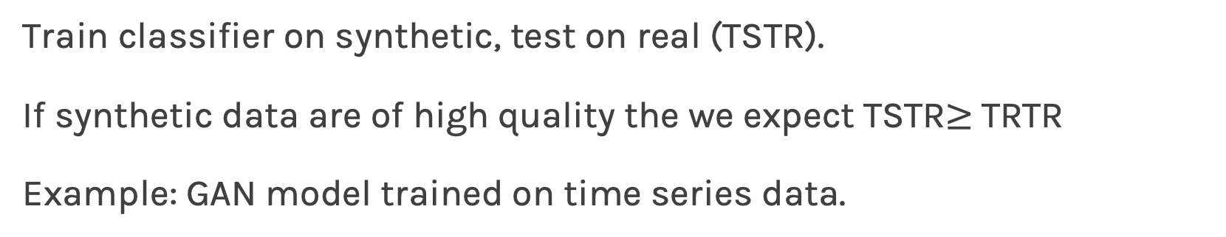
Evaluation: Train Synthetic, Test Real: TSTR
Train classifier on synthetic, test on real (TSTR).
If synthetic data are of high quality the we expect TSTR$≥$TRTR
Example: GAN model trained on time series data.

Slide 30
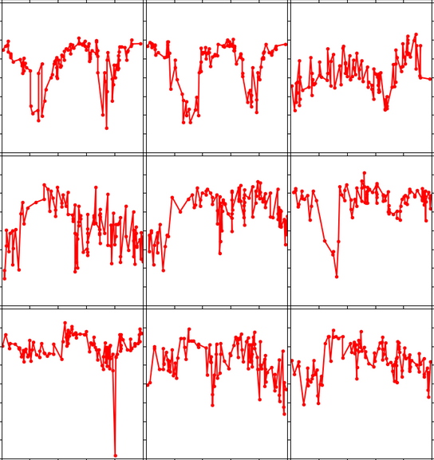
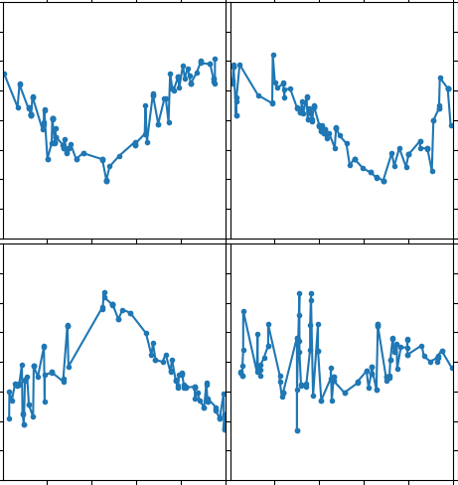
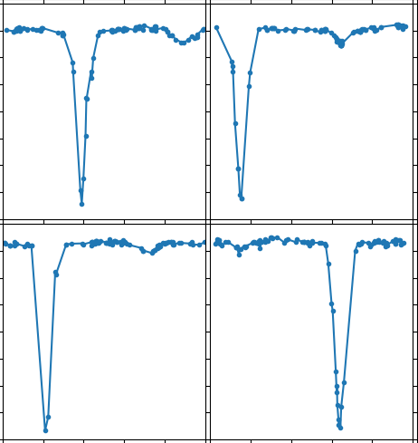
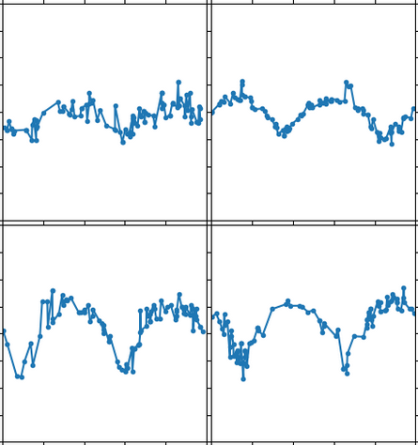
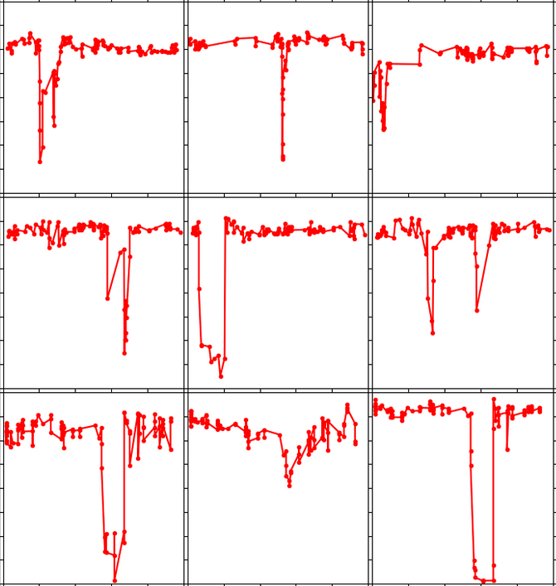
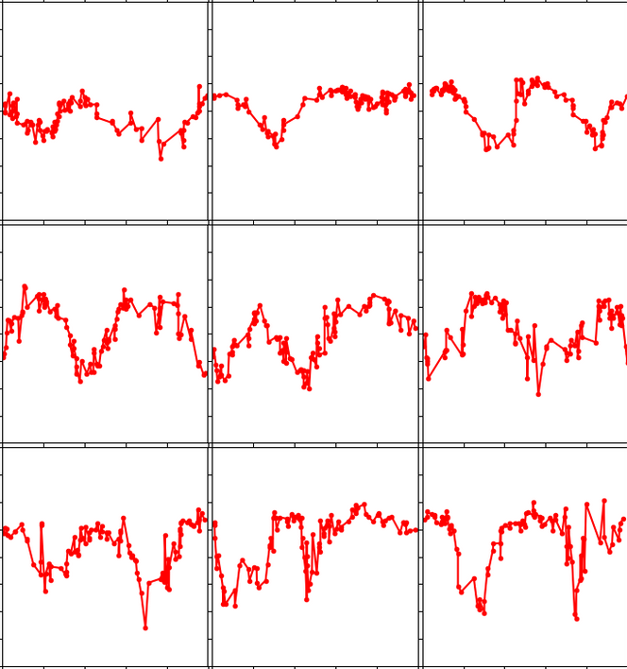
Evaluation: TSTR (cont)
Train on Synthetic Test on Real (TSTR)
Synthetic Data (GAN generated)
Real Data
Class 0
Noise z
Generator
Class 0
Class 1
Class 2
Class 1
Noise z
Generator
Train
Test
Classifier
Class 2
Noise z
Generator
Accuracy on Test is: TSTR
https://arxiv.org/abs/1811.08295

Slide 31
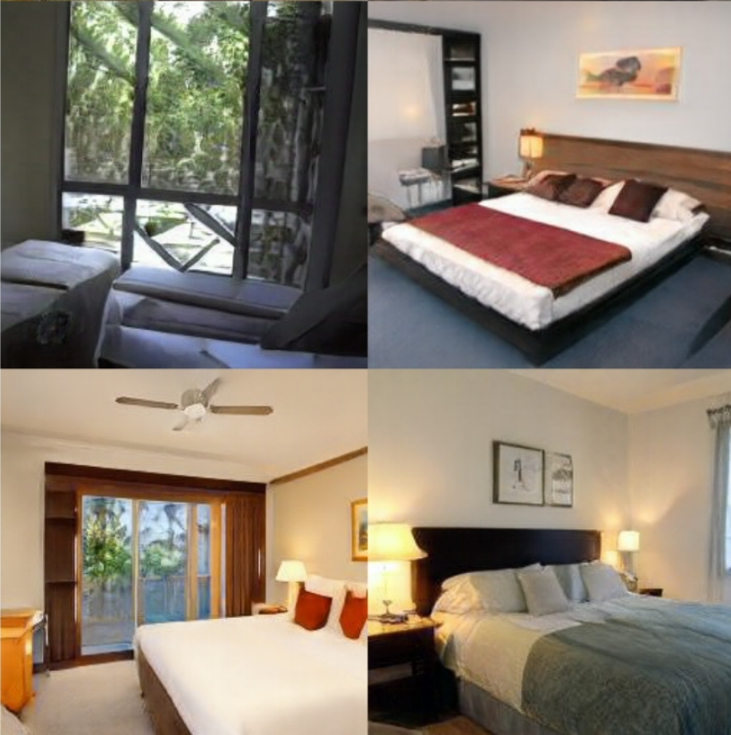
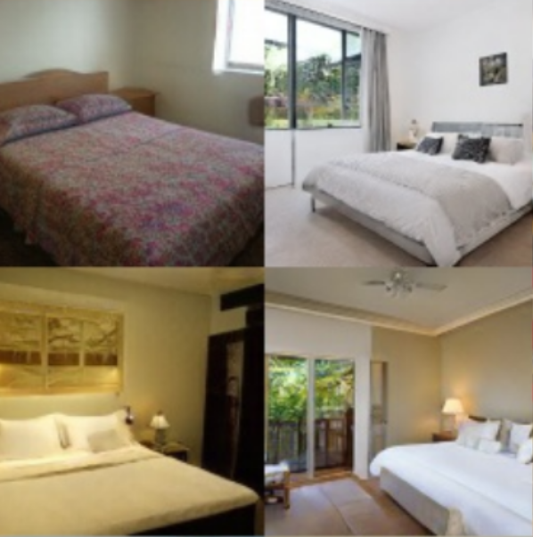
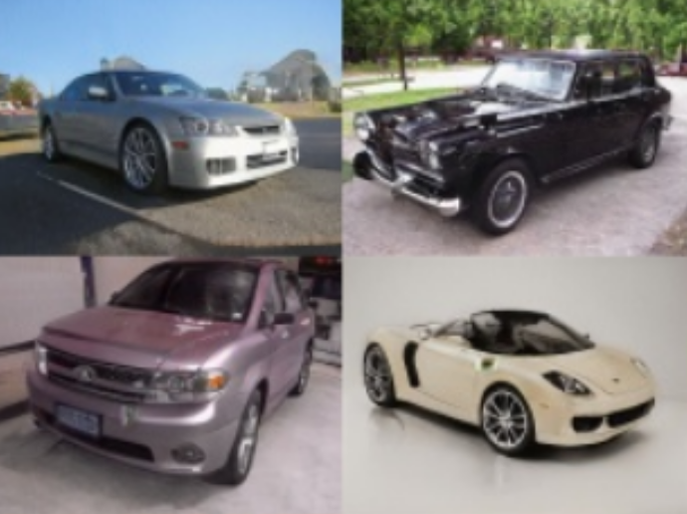
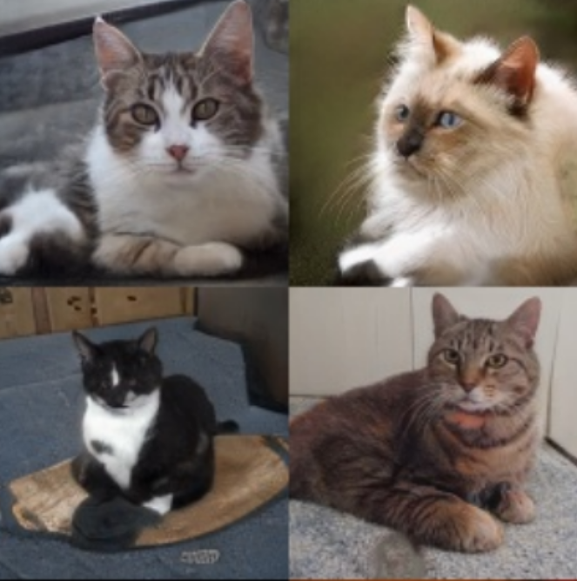
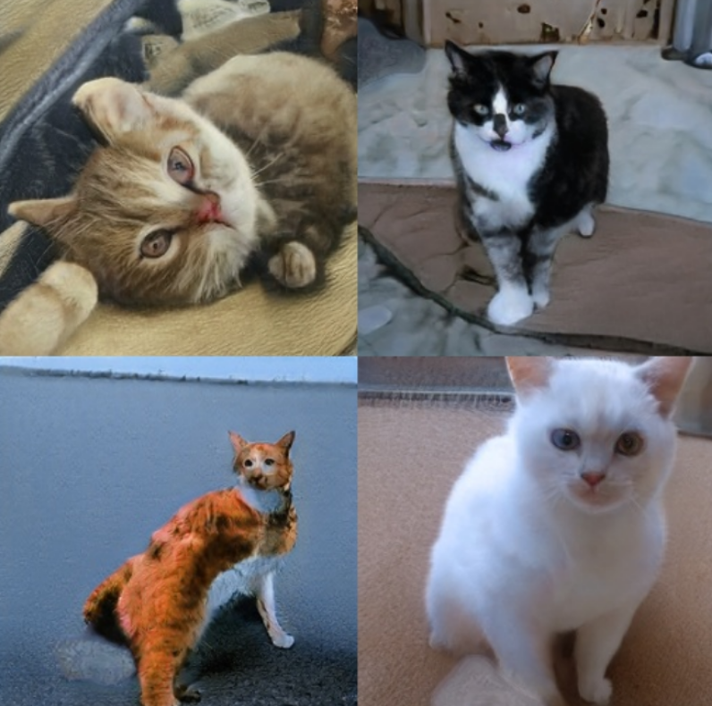
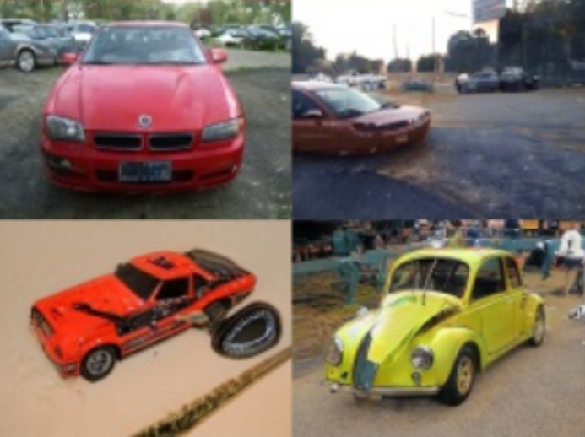
Evaluation: TSTR (cont)
Test on Synthetic Train on Real (TSTR)
Synthetic Data (GAN generated)
Real Data
Class 1
Generator
Class 0
Noise zz
Class 0
Class 2
Generator
Class 1
Noise zz
Train
Test
Classifier
Generator
Class 2
Noise zz
Accuracy on Test is: TSTR

Slide 32

Evaluating GANs: Fréchet Inception Distance
Fréchet Distance (FD)
[Walking your dog in the woods in Polynomial Time]

Slide 33


Evaluating GANs: Fréchet Distance
When we deal with distributions:
1-D normals:
Multivariable normals:

Slide 34
Evaluating GANs: Fréchet Inception Distance
Real data
$$x_{R}$$
Discriminator
Generator
$$D(x)$$
Classification
$$Z$$
$$x_{F}$$
$$z∼p(z)$$
Fake data
$$x_{F}=G(z)$$

Slide 35



Evaluating GANs: Fréchet Inception Distance
Real data
Generator
$$x_{R}$$
$$Z$$
$$x_{F}$$
$$z∼p(z)$$
Fake data
$$x_{F}=G(z)$$

Slide 36






Evaluating GANs: Fréchet Inception Distance
Real data
Assuming that the activations distribute as multivariate Gaussians, compute the W₂ distance between the distributions
Generator
$$x_{R}$$
2048 dimensions
$$Z$$
$$x_{F}$$
2048 dimensions
$$z∼p(z)$$
Fake data
$$x_{F}=G(z)$$
In practice, we use large batches, take $μ_{g}, Σ_{g}$ and the average the $μ_{g}, Σ_{g}$’s over batches.

Slide 37


GANS: Brief timeline
Which one is real? Are you a good Discriminator?
[Analyzing and Improving the Image Quality of StyleGAN]

Slide 38

GANS: Brief timeline
7 years of progress in faces
https://deepgenerativemodels.github.io/assets/slides/cs236_lecture9.pdf
2021

Slide 39

GANS: Brief timeline
~2 years of progress in ImageNet
Auxiliary
Spectral Normalization
Self-Attention
Large Scale GAN Training

Slide 40

GANS: Brief timeline – Original GAN
[Goodfellow et al. 2014]

Slide 41


GANS: Brief timeline: Conditional GAN
$$x_{R}\sim p_{data}(x)$$
$$x_{R}$$
Discriminator
Generator
$$D(x)$$
$$z∼p(z)$$
Classification
Real/Fake
$$Z$$
$$x_{F}$$
$$x_{F}=G(z)$$

Slide 42






GANS: Brief timeline: Conditional GAN
$$x_{R}\sim p_{data}(x|θ)$$
$$x_{R}$$
Discriminator
Generator
$$D(x|θ)$$
$$z∼p(z)$$
Classification
Real/Fake
$$Z$$
$$x_{F}$$
$$x_{F}=G(z|θ)$$
Conditional GANs are an extension of the GANs model. The Generator and Discriminator both receive some additional conditioning input information. This could be the class of the current image or some other property.
$$θ$$
Conditions
42
https://arxiv.org/abs/1411.1784
42

Slide 43

GANS: Brief timeline: Conditional GAN
[Mirza et al. 2014]

Slide 44

Deep Convolutional GAN: DCGAN
Eliminate fully connected layers
Replace all max pooling with convolutional stride
Use transposed convolution or simply upsampling
Batchnorm in G and D except for the input and output layer
ReLU in G for all layers except output, which uses a tanh
[Radford et al. 2015]

Slide 45

Deep Convolutional GAN: DCGAN
Eliminate fully connected layers
Replace all max pooling with convolutional stride
Use transposed convolution or simply upsampling
Batchnorm in G and D except for the input and output layer
ReLU in G for all layers except output, which uses a tanh
[Radford et al. 2015]

Slide 46












Auxiliary Classifier Generative Adversarial Network
$$x_{R}\sim p_{data}(x|θ)$$
Hyperparameter
Binary Classification Real/Fake
$$x_{R}$$
Discriminator
Generator
$$L_{BCE}$$
$$D(x|θ)$$
$$z∼p(z)$$
$$L_{CCE}$$
$$P(y|x,θ)$$
$$Z$$
$$x_{F}$$
Multi Class Classification
$$θ$$
$$x_{F}=G(z|θ)$$
Conditions
$$L=L_{BCE}+λ L_{CCE}$$
FALSE NEGATIVES: Discriminator is passed a fake and it calls it real but the wrong class. In vanilla GAN, the generator would be happy but in this case the Generator still updates.

Slide 47

Auxiliary Classifier Generative Adversarial Network
[Odena et al. 2016]

Slide 48

Wasserstein GAN
They propose a GAN framework base on a metric that correlates with image quality: The Earth Mover Distance, or Wasserstein Distance [Arjovsky et al. 2017]
[Image: Learning with mini-batch Wasserstein]

Slide 49
Wasserstein GAN
Distance is everything:
In general, generative models seek to minimize the distance between real and learned distribution.
Wasserstein (also EM, Earth-Mover) distance:
“Informally, if the distributions are interpreted as two different ways of piling up a certain amount of dirt over the region D, the Wasserstein distance is the minimum cost of turning one pile into the other; where the cost is assumed to be amount of dirt moved times the distance by which it is moved.”
[Image: Learning with mini-batch Wasserstein]

Slide 50


Imagine we started with a distribution $P_{r}$ and wanted to move mass around to change it into $P_{g}$. Moving mass $m$ by distance $d$ costs $m∙d$. To execute this, for all (x,y), move $γ\left(x,y\right)$ mass from x to y
Among all the transport plans, the earth moving (EM) distance corresponds to the cost of the optimal transport plan.

Slide 51


Wasserstein GAN
● Exact computation is intractable.
● Idea: Use a NN to approximate Wasserstein distance.
● Here, we re-use the discriminator, whose outputs are now unbounded.
● We define a custom loss function:
$y_{true}$here is chosen from {-1, 1} according to real/fake
Idea: make predictions for real as large as possible, and for fakes as small as possible
$$W= \frac{1}{n}\sum_{i}{y_{i,pred}y_{i,true}}$$
[Image: Learning with mini-batch Wasserstein]

Slide 52

Wasserstein GAN
The authors claim:
Higher stability during training, less need for carefully balancing generator and discriminator.
Meaningful loss metric, correlating well with sample quality.
Mode collapse is rare.
Learns faster because it does not suffer as much from Vanishing gradients.

Slide 53
Wasserstein GAN
Tips for implementing Wasserstein GAN in Keras.
● Leave the discriminator output unbounded, i.e., apply linear activation.
● Initialize with small weights to not run into clipping issues from the start.
● Remember to run sufficient discriminator updates. This is crucial in the
WGAN setup.
● You can use the Wasserstein surrogate loss implementation below.
● Clip discriminator weights by implementing your own keras constraint

Slide 54



Slide 55



Slide 56



GANS: Brief timeline - Spectral Normalization
Method to stabilize the training of the discriminator and restrict its capacity using a novel weight normalization technique:
where $σ(W)$ is equivalent to the largest singular value of W.
Singular value is very similar to PCA
$${\overline{W}}_{SN}=W/σ(W)$$
[Miyato et al. 2018]

Slide 57


GANS: Brief timeline – Self Attention
[Zhang et al. 2018]

Slide 58


GANS: Brief timeline – Large Scale GAN

Slide 59

GANS: Brief timeline – Large Scale GAN

Slide 60


2017: The explosion of GANs
The GAN Zoo
DEQGAN - Differential Equation GAN
TCGAN – Time Conditional GAN
https://github.com/hindupuravinash/the-gan-zoo

Slide 61
GAN Rules of Thumb (GANHACKs)
Normalize the inputs
normalize the images between -1 and 1
tanh as the last layer of the generator output
Use Spherical Z
Don’t sample from a Uniform distribution
When doing interpolations, do the interpolation via a great circle, rather than a straight line from point A to point B
Tom White's Sampling Generative Networks ref code https://github.com/dribnet/plat has more details

Slide 62
GAN Rules of Thumb (GANHACKs)
Batch Normalization
Construct different mini-batches for real and fake, i.e. each mini-batch needs to contain only all real images or all generated images.
When batchnorm is not an option use instance normalization (for each sample, subtract mean and divide by standard deviation).
Avoid Sparse Gradients: ReLU, MaxPool
The stability of the GAN game suffers if you have sparse gradients
LeakyReLU = good (in both G and D)
For Downsampling, use: Average Pooling, Conv2d + stride
For Upsampling, use: ConvTranspose2d + stride

Slide 63
GAN Rules of Thumb (GANHACKs)
Use Soft and Noisy Labels
Label Smoothing, i.e. if you have two target labels: Real=1 and Fake=0, then for each incoming sample, if it is real, then replace the label with a random number between 0.7 and 1.2, and if it is a fake sample, replace it with 0.0 and 0.3 (for example).
Salimans et. al. 2016
Make the labels noisy for the discriminator: occasionally flip the labels when training the discriminator.
See GANHACKs (https://github.com/soumith/ganhacks) for more tips.

Slide 64
Exercise: Simple exercise to calculate the Fréchet distance.

